Slide 1
WEATHER IMPACT ON ENERGY CONSUMPTION

Slide 2
Introduction
Energy consumption is greatly influenced by changing weather conditions.
Understanding this relationship helps improve planning and resource efficiency.

Slide 3
OBJECTIVE
To analyze how factors like temperature,humidity,and rainfall affect daily energy use.
To visualize and model the relationship between weather and energy consumption.

Slide 4
DATA COLLECTION
Daily weather data : Temperature, Humidity, Rainfall, Wind speed.
Metered energy usage: Daily or Hourly readings.

Slide 5

DATA COLLECTION
Data was processed and visualized using sql, python(jupyter), and power bi
We used real meter readings and weather records for analysis

Slide 6
Weather Forecast Data Captures Daily Information on Temperature, Humidity, Rainfall and Climate Variables
Record ID | ForecastDate | City | TemperatureHigh | Temperature Low | Humidity Percent | WindSpeed KmH | Rainfall MM | Atmospheric Pressure | Energy Consumption
1 | 25-10-2025 | Bangalore | 30.5 | 21.2 | 68.5 | 12.4 | 2.3 | 1012.5 | 118.7
2 | 26-10-2025 | Bangalore | 31 | 20.9 | 70.1 | 15 | 1.2 | 1013 | 120
3 | 27-10-2025 | Bangalore | 29.5 | 19.8 | 72 | 10.5 | 5.6 | 1011.2 | 110.4
4 | 28-10-2025 | Bangalore | 28.7 | 18.9 | 73.5 | 9.9 | 7.2 | 1010.8 | 105.6
5 | 29-10-2025 | Bangalore | 29.2 | 20 | 74.1 | 13.2 | 3.8 | 1012 | 107.8
6 | 30-10-2025 | Bangalore | 30.8 | 21.3 | 67.8 | 14 | 2 | 1012.7 | 122.9
7 | 31-10-2025 | Bangalore | 31.4 | 22.1 | 66 | 11.8 | 1 | 1014.2 | 125.1
8 | 01-11-2025 | Bangalore | 28.9 | 19.2 | 76.4 | 8.7 | 8.9 | 1010.1 | 102.5
9 | 02-11-2025 | Bangalore | 30.2 | 20.5 | 70.7 | 12.9 | 3 | 1011.8 | 115.3
10 | 03-11-2025 | Bangalore | 29.7 | 21 | 73 | 15.4 | 4.5 | 1012.2 | 109.9

Slide 7
Weather Forecast and Energy Consumption Table
Record ID Forecast Date City Temperature High Temperature Low
0 1 2025-10-25 Bangalore 30.5 21.2
1 2 2025-10-26 Bangalore 31.0 20.9
2 3 2025-10-27 Bangalore 29.5 19.8
3 4 2025-10-28 Bangalore 28.7 18.9
4 5 2025-10-29 Bangalore 29.2 20.0
Humidity Percent Wind Speed Km H Rainfall MM Atmospheric Pressure
0 68.5 12.4 2.3 1012.5
1 70.1 15.0 1.2 1013.0
2 72.0 10.5 5.6 1011.2
3 73.5 9.9 7.2 1010.8
4 74.1 13.2 3.8 1012.0
Energy Consumption
0 118.7
1 120.0
2 110.4
3 105.6
4 107.8

Slide 8
DATA CONSUMPTION
0 Record ID 10 non-null int64
1 Forecast Date 10 non-null datetime64[ns]
2 City 10 non-null object
3 Temperature High 10 non-null float64
4 Temperature Low 10 non-null float64
5 Humidity Percent 10 non-null float64
6 Wind Speed Km H 10 non-null float64
7 Rainfall MM 10 non-null float64
8 Atmospheric Pressure 10 non-null float64
9 Energy Consumption 10 non-null float64
10 Day Type 10 non-null object
D types: datetime64[ns](1), float64(7), int64(1), object(2)
memory usage: 1012.0+ bytes
None

Slide 9
VISUAL DESCRIPTIONS
LINE CHART
BAR CHART
SCATTER PLOT
CORRELATION

Slide 10
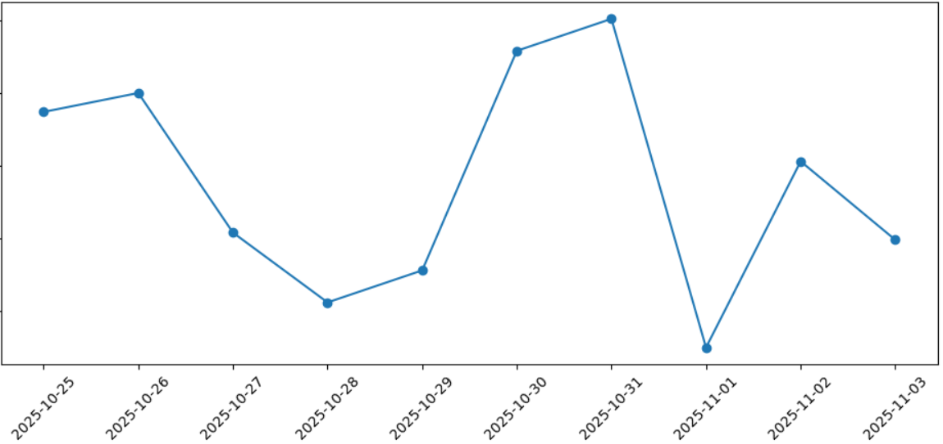
LINE CHART
105
110
115
DAILY ENERGY CONSUMPTION
120
125
DATES OF ENERGY CONSUMPTION

Slide 11
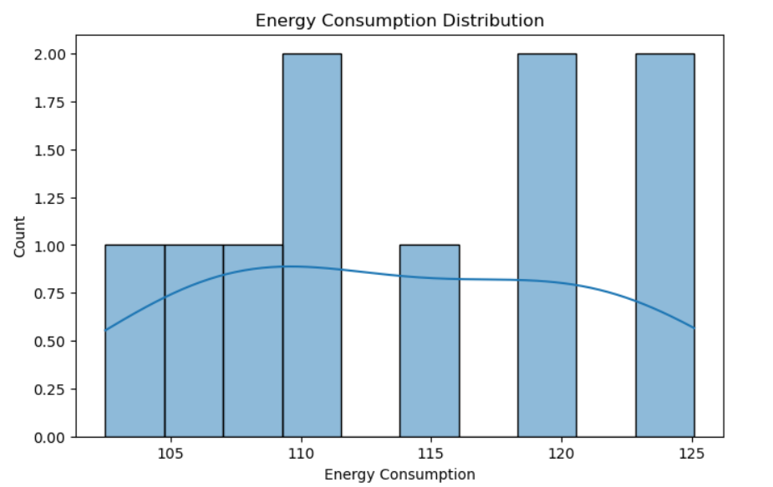
DAILY ENERGY CONSUMPTION
NUMBER OF DAYS
DAILY CONSUMPTION

Slide 12
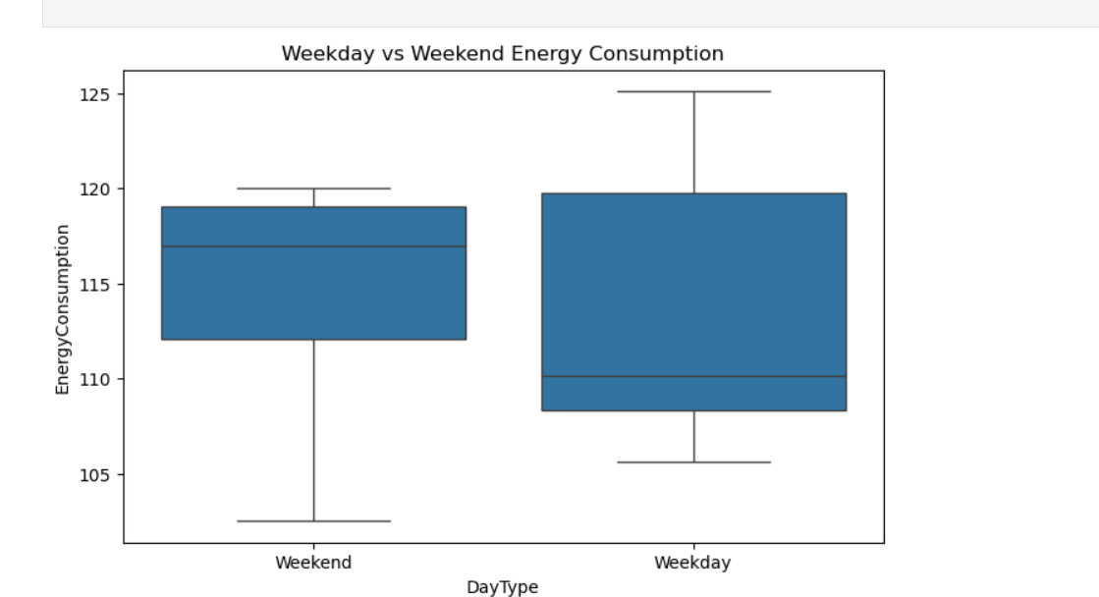
WEEKEND VS WEEKDAYS CONSUMPTION
ENERGY CONSUMPTION
DAY TYPE

Slide 13
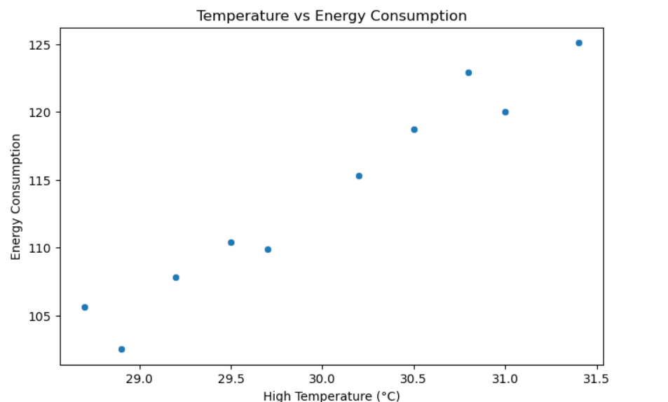
SCATTER PLOT

Slide 14
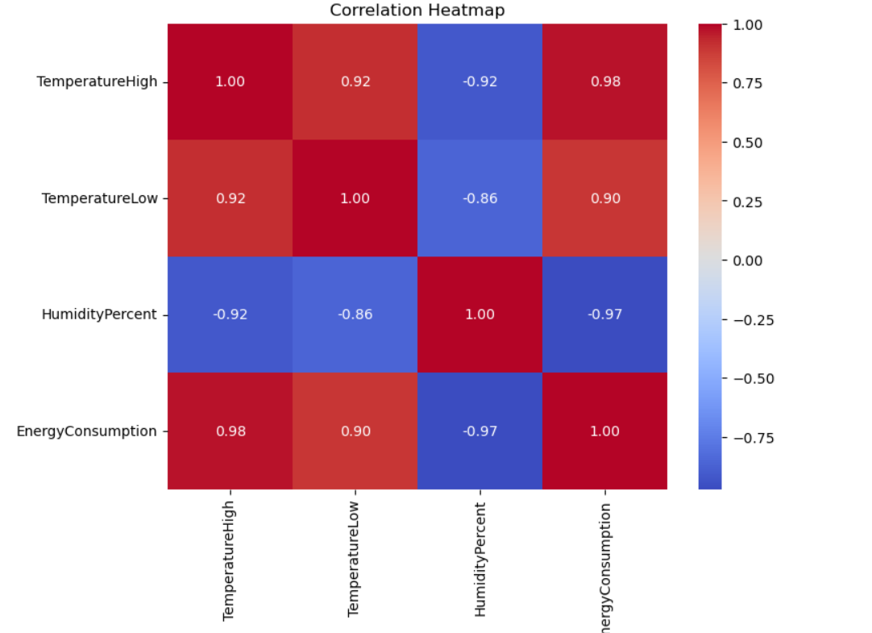
HEAT MAP
TempertureHigh
TempertureLow
Humidity percent
EnergyConsumption
TempertureHigh
TempertureLow
Humidity percent
EnergyConsumption

Slide 15
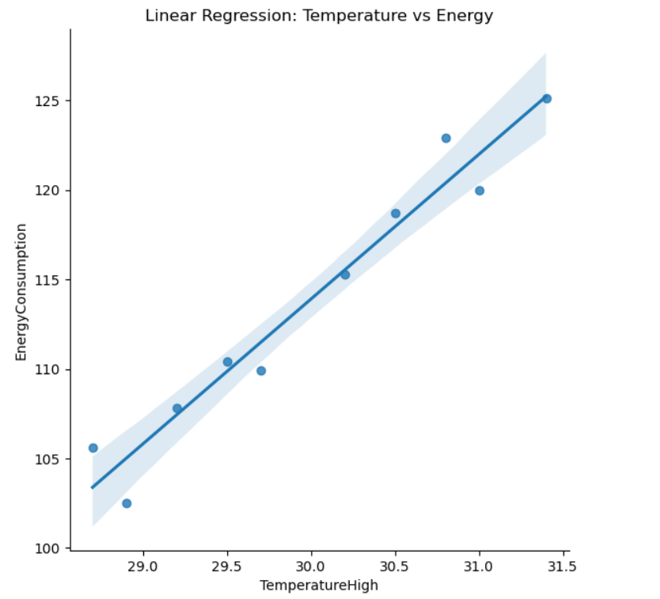
TEMPERATURE VS ENERGY
ENERGY CONSUMPTION
TEMPERATURE HIGH

Slide 16
KEY INSIGHTS AND INTERPRETATION
There is clear, positive correlation between hot weather and higher energy usage.
Energy use patterns change on weekends versus weekdays, during different weather events

Slide 17
This project demonstrates how weather factors can significantly impact daily energy use.
By combing SQL, PYTHON and POWER BI, we have uncovered meaningful patterns and trends in data.
These insights can help optimize energy planning and support data-driven decision making in the future.

Slide 18
CONCLUSION
Weather factors have a direct and measurable effect on energy consumption.
Insights from this analysis can help optimize energy distribution and reduce waste.

Slide 19
THANK YOU
PRESENTation by : Kavana S , Amrutha T N
Government first grade college
Yelahanka nes Bangalore

